Slide 1
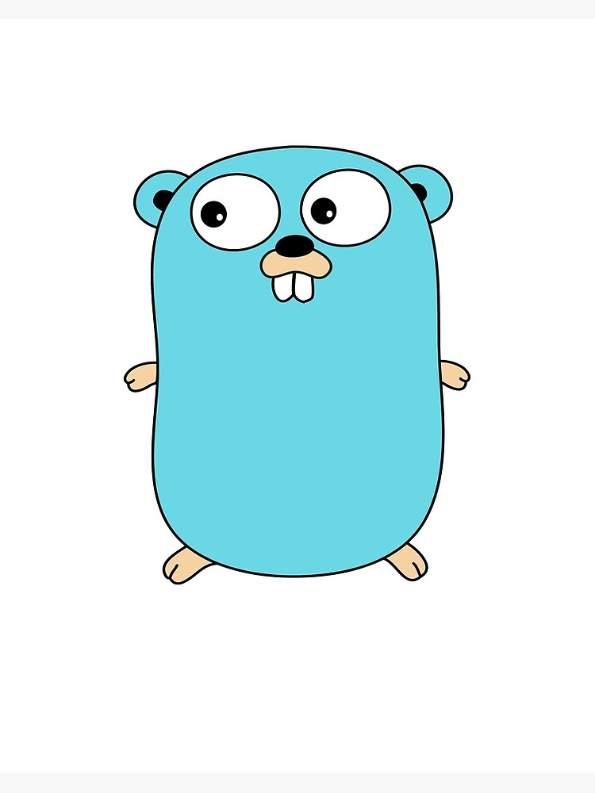
For in GO
Codebeispiel
for i:=0; i<5; i++ {
fmt.Println („Hello World zum “, i+1, „. Mal.“)
}
Syntax generell (pseudo)
for initialization; condition; postcondition {
//do something
}
for initialization; condition; postcondition
// do something

